Slide 1

Database Environment

Slide 2
Objectives
Purpose of three-level database architecture.
Contents of external, conceptual, and internal levels.
Purpose of external/conceptual and conceptual/internal mappings.
Meaning of logical and physical data independence.
Distinction between DDL and DML.

Slide 3
Objectives
Purpose/importance of conceptual modeling.
Function and importance of system catalog.

Slide 4
Objectives of Three-Level Architecture
All users should be able to access same data.
A user’s view is immune to changes made in other views.
Users should not need to know physical database storage details.

Slide 5
Objectives of Three-Level Architecture
All users should be able to access same data.
A user’s view is immune to changes made in other views.
Users should not need to know physical database storage details.

Slide 6
Objectives of Three-Level Architecture
DBA should be able to change database storage structures without affecting the users’ views.
Internal structure of database should be unaffected by changes to physical aspects of storage.
DBA should be able to change conceptual structure of database without affecting all users.

Slide 7
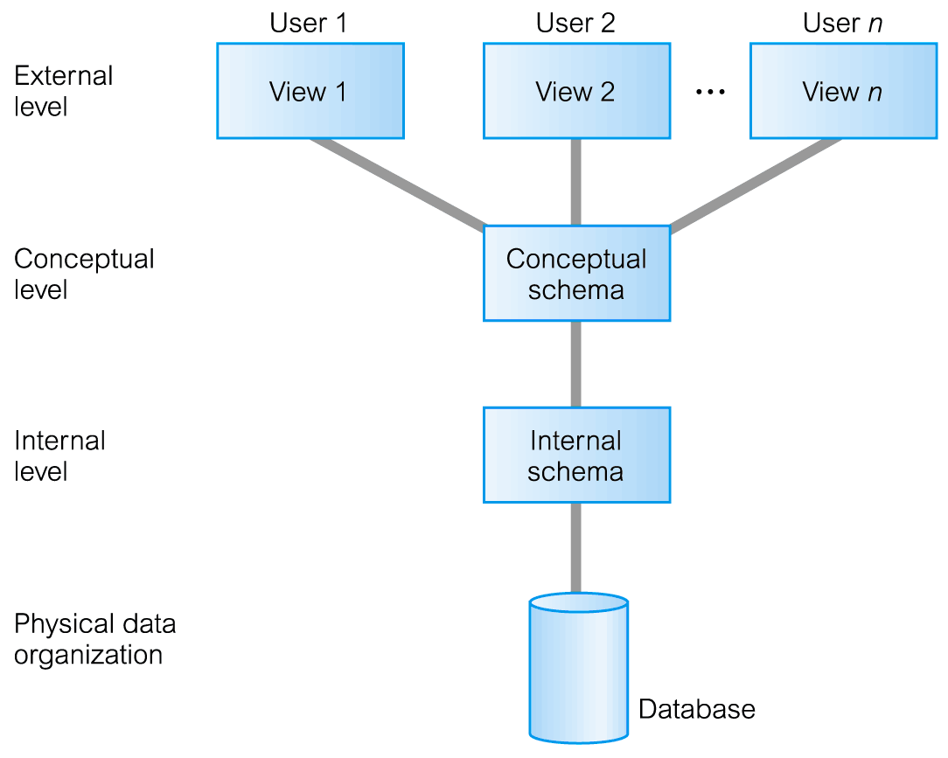
ANSI-SPARC Three-Level Architecture

Slide 8
ANSI-SPARC Three-Level Architecture
External Level
Users’ view of the database.
Describes that part of database that is relevant to a particular user.
Conceptual Level
Community view of the database.
Describes what data is stored in database and relationships among the data.

Slide 9
ANSI-SPARC Three-Level Architecture
Internal Level
Physical representation of the database on the computer.
Describes how the data is stored in the database.

Slide 10
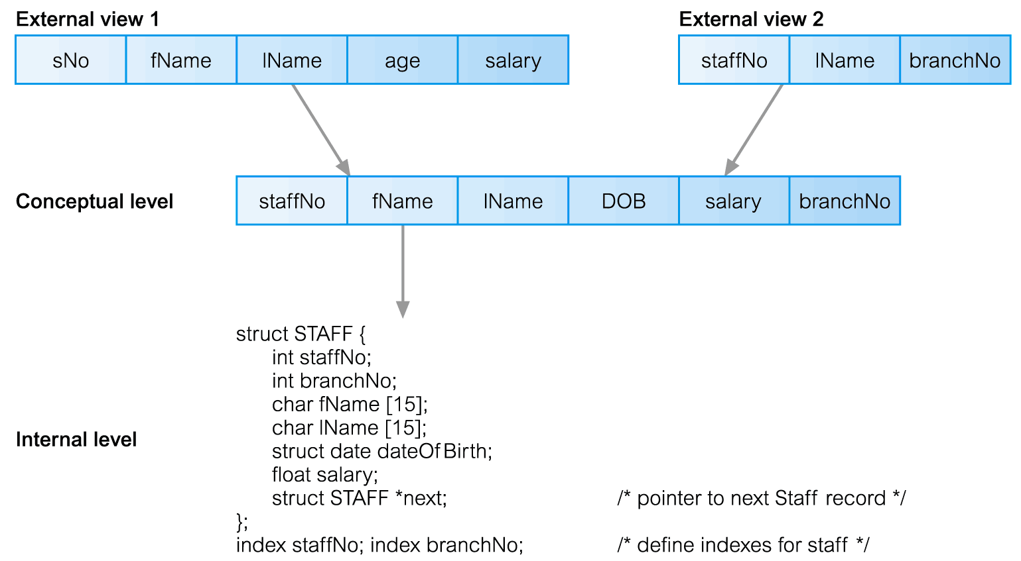
Differences between Three Levels of ANSI-SPARC Architecture

Slide 11
Data Independence
Logical Data Independence
Refers to immunity of external schemas to changes in conceptual schema.
Conceptual schema changes (e.g. addition/removal of entities).
Should not require changes to external schema or rewrites of application programs.

Slide 12
Data Independence
Physical Data Independence
Refers to immunity of conceptual schema to changes in the internal schema.
Internal schema changes (e.g. using different file organizations, storage structures/devices).
Should not require change to conceptual or external schemas.

Slide 13
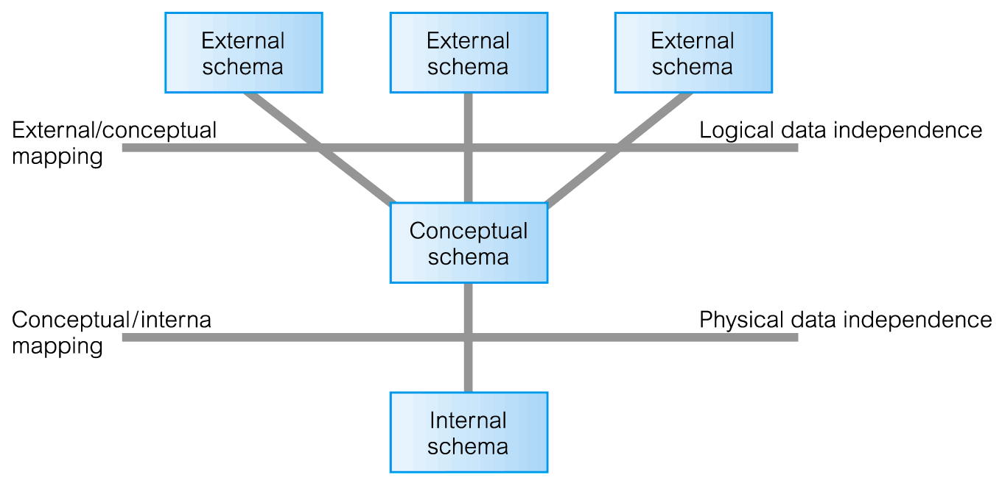
Data Independence and the ANSI-SPARC Three-Level Architecture

Slide 14
Database Languages
Data Definition Language (DDL)
Allows the DBA or user to describe and name entities, attributes, and relationships required for the application
plus any associated integrity and security constraints.

Slide 15
Database Languages
Data Manipulation Language (DML)
Provides basic data manipulation operations on data held in the database.
Procedural DML
allows user to tell system exactly how to manipulate data.
Non-Procedural DML
allows user to state what data is needed rather than how it is to be retrieved.
Fourth Generation Languages (4GLs)

Slide 16
Data Modeling and Data Models
Data modeling: Iterative and progressive process of creating a specific data model for a determined problem domain
Data models: Simple representations of complex real-world data structures
Useful for supporting a specific problem domain
Model - Abstraction of a real-world object or event

Slide 17
Importance of Data Models
Are a communication tool
Give an overall view of the database
Organize data for various users
Are an abstraction for creation of good database

Slide 18
Data Model Basic Building Blocks
Entity: Unique and distinct object used to collect and store data
Attribute: Characteristic of an entity
Relationship: Describes an association among entities
One-to-many (1:M) Many-to-many (M:N or M:M)
One-to-one (1:1)
Constraint: Set of rules to ensure data integrity

Slide 19
Business Rules or Business Process
Brief, precise, and unambiguous description of a policy, procedure, or principle
Enable defining the basic building blocks
Describe main distinguishing characteristics of the data

Slide 20
Sources of Business Rules
Company managers
Policy makers
Department managers
Written documentation
Direct interviews with end user

Slide 21
Reasons for Identifying and Documenting Business Rules
Help standardize company’s view of data
Communications tool between users and designers
Allow designer to:
Understand the nature, role, scope of data, and business processes
Develop appropriate relationship participation rules and constraints
Create an accurate data model

Slide 22
Translating Business Rules into Data Model Components
Nouns translate into entities
Verbs translate into relationships among entities
Relationships are bidirectional
Questions to identify the relationship type
How many instances of B are related to one instance of A?
How many instances of A are related to one instance of B?

Slide 23
Naming Conventions
Entity names - Required to:
Be descriptive of the objects in the business environment
Use terminology that is familiar to the users
Attribute name - Required to be descriptive of the data represented by the attribute
Proper naming:
Facilitates communication between parties
Promotes self-documentation

Slide 24
Data Model
Integrated collection of concepts for describing data, relationships between data, and constraints on the data in an organization.
Data Model comprises:
a structural part;
a manipulative part;
possibly a set of integrity rules.

Slide 25
Data Model
Purpose
To represent data in an understandable way.
Categories of data models include:
Object-based
Record-based
Physical.

Slide 26
Data Models
Object-Based Data Models
Entity-Relationship
Semantic
Functional
Object-Oriented.
Record-Based Data Models
Relational Data Model
Network Data Model
Hierarchical Data Model.
Physical Data Models

Slide 27
Hierarchical and Network Models
Hierarchical Models
Manage large amounts of data for complex manufacturing projects
Represented by an upside- down tree which contains segments
Segments: Equivalent of a file system’s record type
Depicts a set of one-to-many (1:M) relationships
Network Models
Represent complex data relationships
Improve database performance and impose a database standard
Depicts both one-to-many (1:M) and many-to-many (M:N) relationships

Slide 28
Hierarchical Model
Advantages
Promotes data sharing
Parent/child relationship promotes conceptual simplicity and data integrity
Database security is provided and enforced by DBMS
Efficient with 1:M relationships
Disadvantages
Requires knowledge of physical data storage characteristics
Navigational system requires knowledge of hierarchical path
Changes in structure require changes in all application programs
Implementation limitations
No data definition
Lack of standards

Slide 29
Network Model
Advantages
Conceptual simplicity
Handles more relationship types
Data access is flexible
Data owner/member relationship promotes data integrity
Conformance to standards
Includes data definition language (DDL) and data manipulation language (DML)
Disadvantages
System complexity limits efficiency
Navigational system yields complex implementation, application development, and management
Structural changes require changes in all application programs

Slide 30
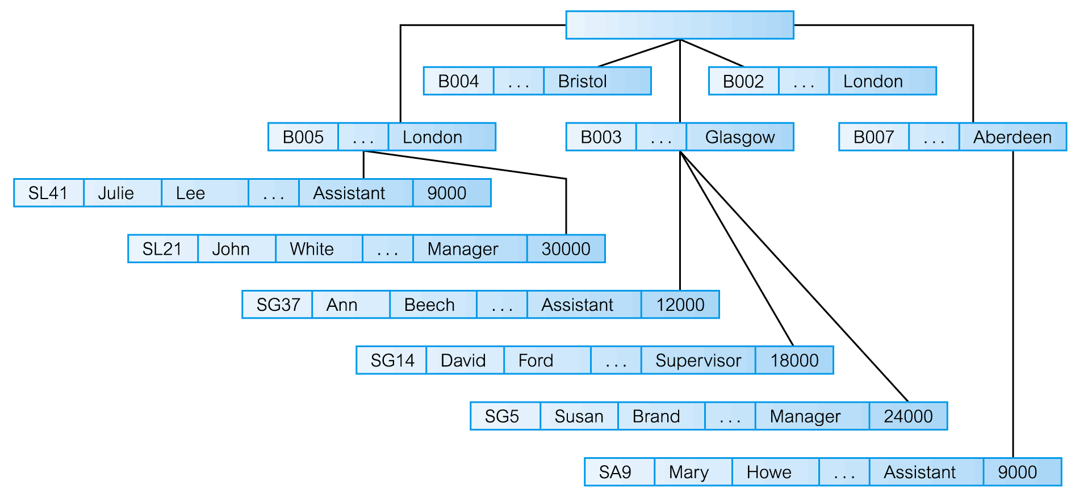
Hierarchical Data Model

Slide 31
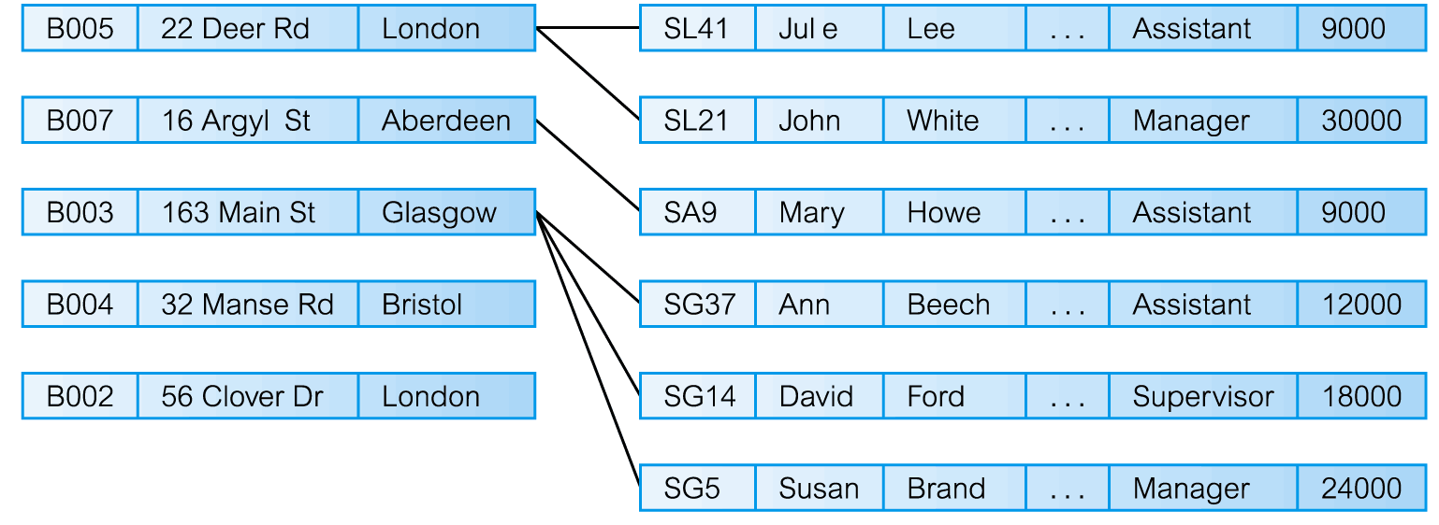
Network Data Model

Slide 32
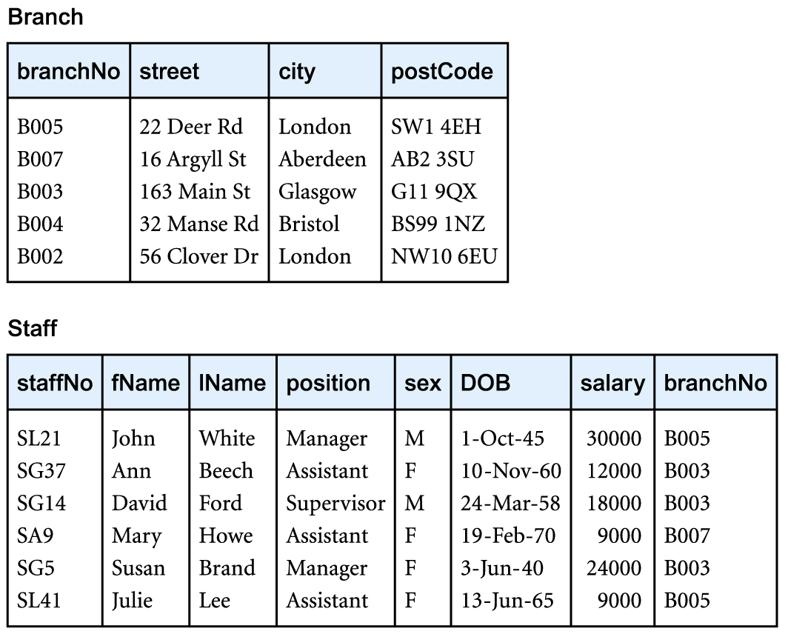
Relational Data Model
Table1 - Characteristics of a Relational Table

Slide 33
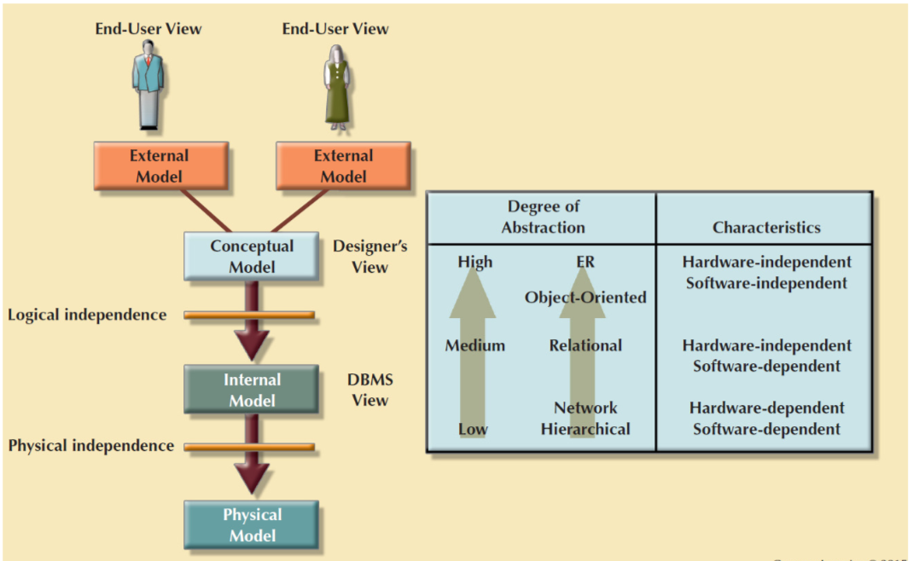
Data Abstraction Levels

Slide 34
Standard Database Concepts
Schema
Conceptual organization of the entire database as viewed by the database administrator
Subschema
Portion of the database seen by the application programs that produce the desired information from the data within the database

Slide 35
Schemas
Database Schema: The description of a database. Includes descriptions of the database structure and the constraints that should hold on the database.
Schema Diagram: A diagrammatic display of (some aspects of) a database schema.
Schema Construct: A component of the schema or an object within the schema, e.g., STUDENT, COURSE.
Database State/Snapshot: The actual data stored in a database at a particular moment in time. Also called the current set of occurrences/instances).

Slide 36
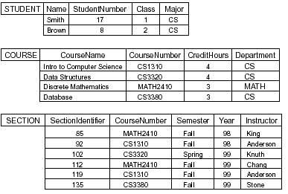
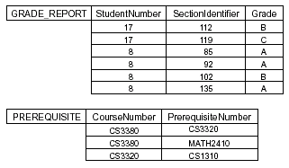
An Example of Database

Slide 37
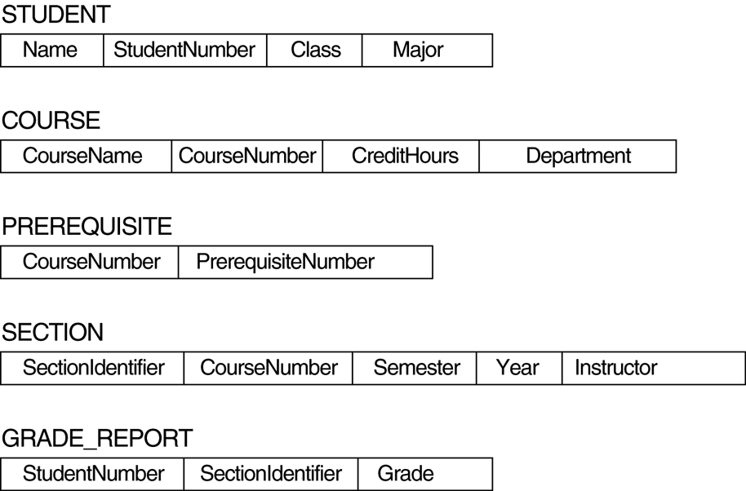
Schema diagram

Slide 38
Database Schema Vs. Database State
Database State: Refers to the content of a database at a moment in time.
Initial Database State: Refers to the database when it is loaded
Valid State: A state that satisfies the structure and constraints of the database.
Distinction
The database schema changes very infrequently. The database state changes every time the database is updated.
Schema is also called intension, whereas state is called extension.

Slide 39
Physical Data Models
Physical data models describe how data is stored in the computer, representing information such as record structures, record orderings, and access paths.
There are not as many physical data models as logical data models; the most common ones are the unifying model and the frame memory.

Slide 40
Conceptual Modeling
Conceptual schema is the core of a system supporting all user views.
Should be complete and accurate representation of an organization’s data requirements.
Conceptual modeling is process of developing a model of information use that is independent of implementation details.
Result is a conceptual data model.

Slide 41
System Catalog
Repository of information (metadata) describing the data in the database.
One of the fundamental components of DBMS.
Typically stores:
names, types, and sizes of data items;
constraints on the data;
names of authorized users;
data items accessible by a user and the type of access;
usage statistics.

